Slide 1

GAINING THE COMPETITIVE EDGE
Analyzing Candidate-Party Congruence and Issue Salience of Campaign
Winners in 2021 German Federal Elections
Philipp Kläger
SNR: 2062105

Slide 2
I. Introduction
Figure 1. Poll history for the 2021 German Federal Elections (own rep.; based on Forsa 2022)
Motivation
Tight electoral campaigning for 2021 German Federal Elections (fig. 1)
Central paper(s)
Problem Statement
xxx

Slide 3
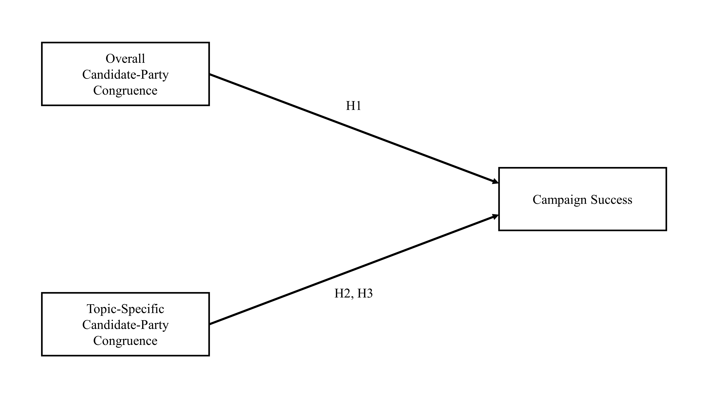
II. Model
Correlational Research Design (ANOVA tests)
Six Parties: AfD, CDU/CSU, FDP, Greens, The Left & SPD
Campaign Groups: campaign winners vs. campaign losers
Figure 2. Conceptual Model (own rep.)

Slide 4
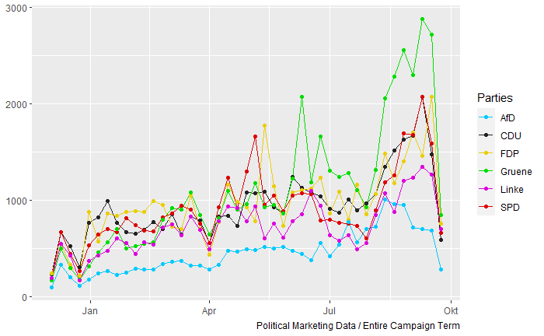
III. Data
Campaign period: Dec. 8, 2020 – Sep. 26, 2022
Two data sets collected:
Data 1. Candidate Tweets (218,256 observations)
Data 2. Party Manifestos (2017 & 2021 German Federal Elections)
Figure 3. Total volume of candidate tweets (own rep.).

Slide 5
IV. Methodology
Table 1. Wordscore Procedure (own rep.)
 | Methodological Procedure (Laver et al., 2003; Martin & Vanberg, 2007) | Application of this Research
Step 1. | A Priori Model Calibration collecting reference texts assigning reference scores to reference texts collecting virgin texts | 2017 party manifestos 2019 Chapel Hill Expert Survey 2021 party manifestos and 2021 campaign period tweets
Step 2. | Computing Wordscores & Reference Textscores
Step 3. | Computing Virgin Textscores
Step 4. | Robust Transformation of Scores
Step 5. Difference Testing
ANOVA Tests + Tukey Post-Hoc Tests

Slide 6
V. Results

Slide 7
VI. Conclusions

Slide 8
Sources
Forsa. (2022, March 1). Sonntagsfrage – Forsa (Wahlumfragen zur Bundestagswahl) [Sunday Surveys - Forsa (electoral surveys regarding the German Federal Elections)]. Wahlrecht.de / Forsa Institute. Retrieved March 3, 2022, from https://www.wahlrecht.de/umfragen/forsa.htm
Laver, M., Benoit, K., & Garry, J. (2003). Extracting Policy Positions from Political Texts Using Words as Data. American Political Science Review, 97(02). https://doi.org/10.1017/s0003055403000698
Martin, L. W., & Vanberg, G. (2007). A Robust Transformation Procedure for Interpreting Political Text. Political Analysis, 16(1), 93–100. https://doi.org/10.1093/pan/mpm010

